Slide 1
Lecture 18 & 19
Number Representation and Arithmetic Circuits
Chapter Objectives
In this chapter you will learn about:
• Representation of numbers in computers
• Circuits used to perform arithmetic operations

Slide 2
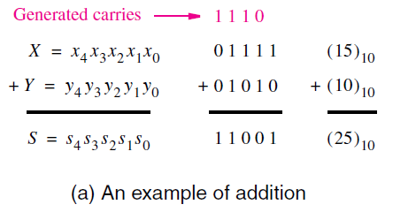
Addition of multibit numbers.
In the case of larger numbers, multiple bits are involved.
Then it is still necessary to add each pair of bits, but for each bit position i, the addition operation may include a carry-in from bit position i − 1.
Consider the example,
Figure presents an example of the addition operation. The two operands are X = (01111)₂ = (15)₁₀ and Y = (01010)₂ = (10)₁₀.
Individual bits are labelled such that X = x₄x₃x₂x₁x₀ and Y = y₄y₃y₂y₁y₀.
Hence, the sum S = X + Y = (25)₁₀ can also be denoted as a five-bit integer.

Slide 3
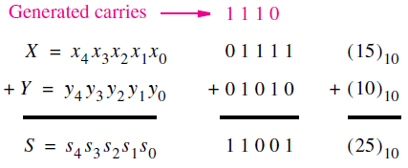
Contd..
The carries generated during the addition process are marked in pink colour.
For example, a carry of 0 is generated when x₀ and y₀ are added, a carry of 1 is produced when x₁ and y₁ are added, and so on.
Designing the adder circuit after forming of a truth table is impractical here:
Truth table would have 10 input variables.
5 for each number X and Y .
So it would have 2¹⁰ = 1024 rows

Slide 4
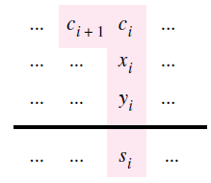
Contd..
A better approach in design is to consider the addition of each pair of bits, x_{i} and y_{i} , separately.
For bit position 0, there is no carry-in, and hence the addition is the same as Half Adder.
For each other bit position i, the addition involves bits x_{i} and y_{i} , and a carry-in c_{i} , as illustrated in figure.

Slide 5
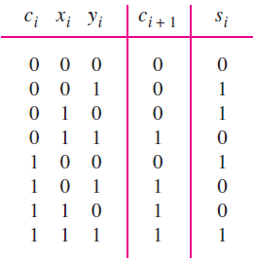
Contd..
So, the logic circuit will have three inputs x_{i}, y_{i}, and c_{i} , and produces the two outputs s_{i} and c_{i+1}.
The required truth table is as shown.
The sum bit, s_{i} , is the modulo-2 sum of x_{i}, y_{i}, and c_{i}.
The carry-out, c_{i+1}, is equal to 1 if the sum of x_{i} , y_{i} , and c_{i} is equal to either 2 or 3.
The logic circuit implementing the truth table is called as a full-adder.

Slide 6
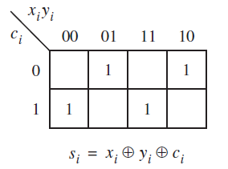
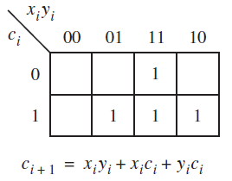
Contd..
Karnaugh maps for the sum and carry are shown below.
For the carry-out function the optimal sum-of-products realization is
c_{i+1} = x_{i}y_{i} + x_{i}c_{i} + y_{i}c_{i}
For the s_{i} function a sum-of-products realization is

Slide 7
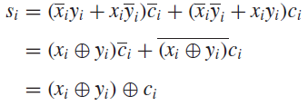
Use of XOR Gates
A more attractive way of implementing this function is by using the XOR gates, as given below.
The XOR function of two variables is defined as
The preceding expression for the sum bit can be manipulated into a form that uses only XOR operations as follows
The XOR operation is associative hence we can write
Therefore, a three-input XOR operation can be used to realize s_{i}.

Slide 8
Contd..
The XOR operation generates as an output a modulo-2 sum of its inputs.
Thus, the output is equal to 1 if an odd number of inputs have the value 1, and it is equal to 0 otherwise.
For this reason the XOR is sometimes referred to as the odd function.
Observe that the XOR has no minterms that can be combined into a larger product term, as evident from the checkerboard pattern for function s_{i} in the map.

Slide 9
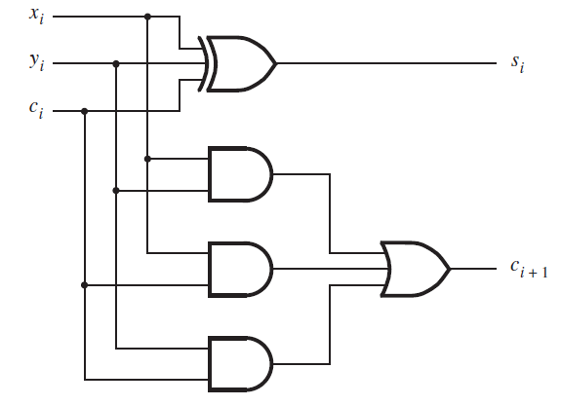
Full Adder circuit
c_{i+1} = x_{i}y_{i} + x_{i}c_{i} + y_{i}c_{i}

Slide 10
More about XOR gates..
A two-input XOR gate can also be thought of as using one input as a control signal that determines whether the true or complemented value of the other input will be passed through the gate as the output value.
This can be verified from the definition of XOR operation,
Consider x₁ to be the control input. Then if x₁ = 0, the output will be equal to the value of x₂.
But if x₁ = 1, the output will be equal to the complement of x₂.

Slide 11
Contd..
In the earlier derivation, we used algebraic manipulation to derive s_{i}
s_{i} = (x_{i} ⊕ y_{i}) ⊕ c_{i} .
We could have obtained the same expression immediately by making the following observation.
In the top half of the truth table, c_{i} is equal to 0, and the sum function s_{i} is the XOR of x_{i} and y_{i} .
In the bottom half of the table, c_{i} is equal to 1, while s_{i} is the complemented version of its top half.
This observation leads directly to our expression using 2 two-input XOR operations.
In the preceding discussion we encountered the complement of the XOR called as XNOR denoted by ( )
The XNOR is sometimes also referred to as the coincidence operation
because it produces the output of 1 when its inputs coincide in value; that is, they are both 0 or both 1.

Slide 12
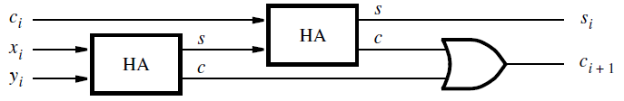
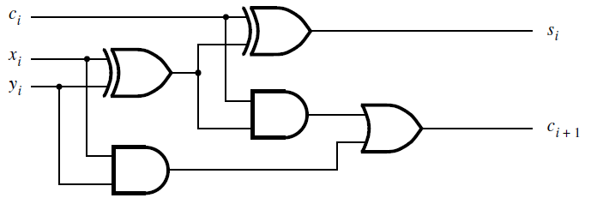
Decomposed Full-Adder
In view of the names used for the circuits, one can expect that a full-adder can be constructed using half-adders.
This can be accomplished by creating a circuit given in figure.
It uses two half-adders to form a full-adder.

Slide 13
Ripple Carry Adder - Multibit adder
To perform addition by hand, we start from the least-significant digit and add pairs of digits, progressing to the most-significant digit.
If a carry is produced in position i, then this carry is added to the operands in position i + 1.
The same arrangement can be used in a logic circuit that performs addition.
Hence, for each bit position we can use a full-adder circuit.

Slide 14
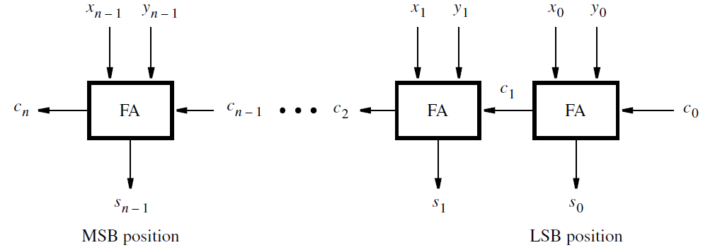
An n-bit ripple-carry adder
The addition of such numbers does not require a carry-in for stage 0.
In Figure, we included c₀ in the diagram so that the ripple-carry adder can also be used for subtraction of numbers (will study in next topic)
Carries that are produced by the full-adders propagate to the left.

Slide 15
Delay in ripple carry adder
When the operands X and Y are applied as inputs to the adder, it takes some time before the output sum, S, is valid.
Each full-adder introduces a certain delay before its s_{i} and c_{i+1} outputs are valid.
Let this delay be denoted as Δt.
Thus the carry-out from the first stage, c₁, arrives at the second stage Δt after the application of the x₀ and y₀ inputs.
The carry-out from the second stage, c₂, arrives at the third stage with a 2Δt delay, and so on.

Slide 16
Contd..
The signal c_{n−1} is valid after a delay of (n − 1)Δt, which means that the complete sum is available after a delay of nΔt.
Because of the way the carry signals “ripple” through the full-adder stages, this n-bit adder circuit is called a ripple-carry adder.
The delay incurred to produce the final sum and carry-out in a ripple-carry adder depends on the size of the numbers.
When 32- or 64-bit numbers are used, this delay may become unacceptably high.
So, other implementations will have to adopted

Slide 17
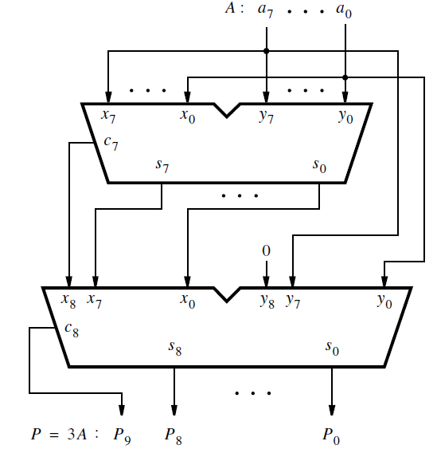
Design Example
Design a circuit that multiplies an eight-bit unsigned number by 3.
Let A = a₇a₆ · · · a₁a₀ denote the number and P = p₉p₈ · · · p₁p₀ denote the product P = 3A.
Note that 10 bits are needed to represent the product.
A simple approach to design the required circuit is to use two ripple-carry adders to add three copies of the number as shown in figure.
The symbol that denotes each adder is a commonly-used graphical symbol for adders.

Slide 18
The letters x_{i} , y_{i} , s_{i} , and c_{i} indicate the meaning of the inputs and outputs.
The first adder produces A + A = 2A.
Its result is represented as eight sum bits and the carry from the most-significant bit.
The second adder produces 2A + A = 3A.
It has to be a nine-bit adder to be able to handle the nine bits of 2A, which are generated by the first adder.
Because the y_{i} inputs have to be driven only by the eight bits of A, the ninth input y₈ is connected to a constant 0.

Slide 19
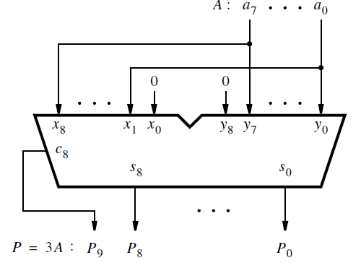
Efficient design of 3A circuit
The earlier approach is straightforward, but not very efficient.
Because 3A = 2A + A, we can observe that 2A can be generated by shifting the bits of A one bit-position to the left, which gives the bit pattern a₇a₆a₅a₄a₃a₂a₁a₀0.
Then a single ripple-carry adder suffices for implementing 3A, as shown in Figure.
This is essentially the same circuit as the second adder in previous case with 9 bit inputs.
Note that the input x₀ is connected to a constant 0.
Note also that in the second adder in previous case also the value of x₀ is always 0, even though it is driven by the least-significant bit, s₀, of the sum of the first adder.
Because x₀ = y₀ = a₀ in the first adder, the sum bit s₀ will be 0, whether a₀ is 0 or 1.

Slide 20
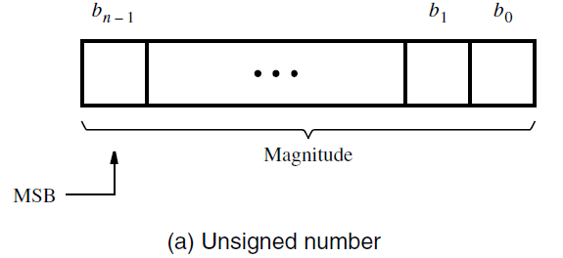
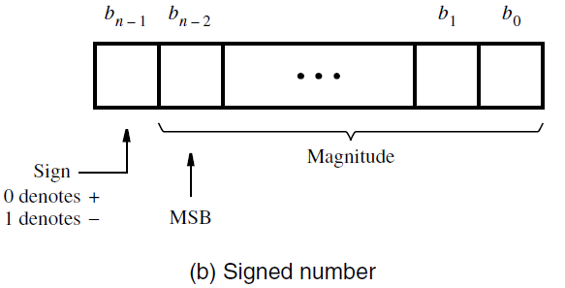
Signed Numbers
In the decimal system the sign of a number is indicated by a + or − symbol to the left of the most-significant digit.
In the binary system the sign of a number is denoted by the left-most bit.
For a positive number the left-most bit is equal to 0, and for a negative number it is equal to 1.
Therefore, in signed numbers the left-most bit represents the sign, and the remaining n − 1 bits represent the magnitude.
It is important to note the difference in the location of the most-significant bit (MSB).
In unsigned numbers all bits represent the magnitude of a number; hence all n bits are significant in defining the magnitude.
In signed numbers there are n − 1 significant bits, and the MSB is in bit position b_{n−2}.

Slide 21
Binary - Negative Numbers
Positive numbers are represented using the positional number representation as explained in the previous section.
Negative numbers can be represented in three different ways:
1) sign-and-magnitude representation,
2) 1’s complement representation,
3) 2’s complement representation

Slide 22
Sign-and-Magnitude Representation:
In the familiar decimal representation, the magnitude of both positive and negative numbers is expressed in the same way.
The sign symbol distinguishes a number as being positive or negative. This scheme is called the sign-and-magnitude number representation.
The same scheme can be used with binary numbers in which case the sign bit is 0 or 1 for positive or negative numbers, respectively.
For example, if we use four-bit numbers, then +5 = 0101 and −5 = 1101.
Because of its similarity to decimal sign-and-magnitude numbers, this representation is easy to understand.
However, this representation is not well suited for use in computers.
More suitable representations are based on complementary systems.

Slide 23
1’s Complement Representation
In a complementary number system, the negative numbers are defined according to a subtraction operation involving positive numbers.
In the 1’s complement scheme, an n-bit negative number, K, is obtained by subtracting its equivalent positive number, P, from 2^{n} − 1; that is, K = (2^{n} − 1) − P.
For example, if n = 4, then K = (2⁴ − 1) − P = (15)₁₀ − P = (1111)₂ − P.
For e.g. if K= −5. Then K = 1111 − 0101 = 1010.
Similarly, +3 = 0011 and −3 = 1111 − 0011 = 1100.
Clearly, the 1’s complement can be obtained simply by complementing each bit of the number, including the sign bit.
While 1’s complement numbers are easy to derive, they have some drawbacks when used in arithmetic operations.

Slide 24
2’s Complement Representation
In the 2’s complement scheme, a negative number, K, is obtained by subtracting its equivalent positive number, P, from 2^{n}; namely, K = 2^{n} − P.
Using our four-bit example, −5 = 2⁴ – 5 = 10000 − 0101 = 1011, and −3 = 10000 − 0011 = 1101.
Finding 2’s complements in this manner requires performing a subtraction operation that involves borrows.
However, we can observe that if K₁ is the 1’s complement of P and K₂ is the 2’s complement of P,
Then K₁ = (2^{n} − 1) − P and K₂ = 2^{n} − P
Hence, K₂ = K₁ + 1
Thus a simpler way of finding a 2’s complement of a number is to add 1 to its 1’s complement because finding a 1’s complement is easy.
This is how 2’s complement numbers are obtained in logic circuits that perform arithmetic operations.

Slide 25
Easy Rule for Finding 2’s Complements
There is a rather easier way to compute 2’s complement.
Given a number B = b_{n−1}b_{n−2} · · · b₁b₀, its 2’s complement, K = k_{n−1}k_{n−2} · · · k₁k₀, can be found by examining the bits of B from right to left and taking the following action:
Copy all bits of B that are 0 and the first bit that is 1
Then simply complement the rest of the bits.
For example, if B = 0110, then we copy k₀ = b₀ = 0 and k₁ = b₁ = 1, and complement the rest so that k₂ = (b₂)’ = 0 and k₃ = (b₃)’ = 1.
Hence K = 1010.
As another example, if B = 10110100, then K = 01001100.

Slide 26
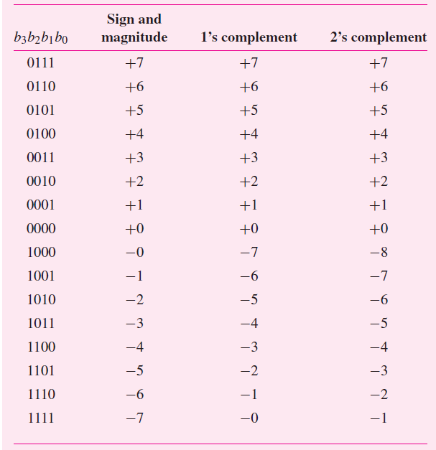
Table illustrates the interpretation of all 16 four-bit patterns in the three signed number representations that we have considered.
Note that for both sign-and-magnitude representation and for 1’s complement representation there are two patterns that represent the value zero.
For 2’s complement there is only one such pattern for zero.
Also, observe that the range of numbers that can be represented with four bits in 2’s complement form is −8 to +7, while in the other two representations it is −7 to +7.
Interpretation of four-bit signed integers.

Slide 27
Contd.
Using 2’s-complement representation, an n-bit number B = b_{n−1}b_{n−2} · · · b₁b₀ represents the value,
V(B) = (−b_{n−1} × 2^{n−1}) + b_{n−2} × 2^{n−2} +· · ·+b₁ × 2¹ + b₀ × 2⁰
Thus the largest negative number, 100 . . . 00, has the value −2^{n−1}.
The largest positive number, 011 . . . 11, has the value 2^{n−1} − 1.

Slide 28
Addition and Subtraction operations
We can compare the advantages of different number representations based on the addition and subtraction operations.
For the illustrations, we can use four-bit numbers, consisting of a sign bit and three significant bits.
Thus the numbers have to be small enough so that the magnitude of their sum can be expressed in three bits, which means that the sum cannot exceed the value 7.
Addition of positive numbers is the same for all three number representations which is same as the addition of unsigned numbers.
But there are significant differences when negative numbers are involved.

Slide 29
Sign and Magnitude Addition
If both operands have the same sign, then the addition of sign-and-magnitude numbers is simple.
The magnitudes are added, and the resulting sum is given the sign of the operands.
However, if the operands have opposite signs, the task becomes more complicated.
Then it is necessary to subtract the smaller number from the larger one.
This means that logic circuits that compare and subtract numbers are also needed.
Hence, the sign-and-magnitude representation is not used in computers.

Slide 30
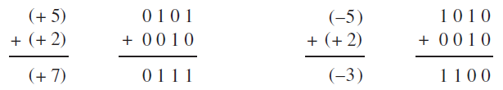
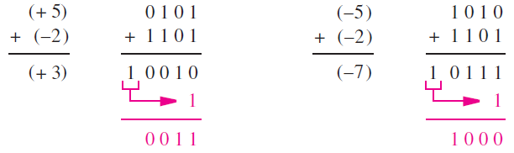
1’s Complement Addition
Advantage of the 1’s complement representation is that a negative number is generated simply by complementing all bits of the corresponding positive number.
Consider the figure below,
As seen above, the computation of 5 + 2 = 7 and (−5) + 2 = (−3) is straightforward
a simple addition of the operands gives the correct result.
But, Computing 5 + (−2) = 3 produces the bit vector 10010 which
is not 3 and there is a carry-out from the sign-bit position.
But, if we add the carry to 10010, we get 0011 which is 3 and is the
desired result.

Slide 31
Contd..
A similar situation arises when adding (−5) + (−2) = (−7).
After the initial addition the result is wrong because the four bits of the sum are 0111, which represents +7 rather than −7.
But again, there is a carry-out from the sign-bit position, which can be used to correct the result by adding it in the LSB position, as shown in Fig.
The conclusion from these examples is that the addition of 1’s complement numbers may or may not be simple.
In some cases a correction is needed, which amounts to an extra addition that must be performed.
Consequently, the time needed to add two 1’s complement numbers may be twice as long as the time needed to add two unsigned numbers.

Slide 32
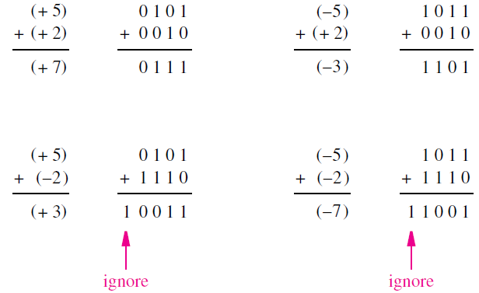
2’s Complement Addition
Lets take the same combinations of numbers as used in the 1’s complement example.
Figure indicates how the addition is performed using 2’s complement numbers.
Adding 5 + 2 = 7 and (−5) + 2 = (−3) is straightforward.

Slide 33
The computation 5 + (−2) = 3 generates the correct four bits of the result, namely 0011.
There is a carry-out from the sign-bit position, which we can simply ignore.
The fourth case is (−5) + (−2) = (−7). Again, the four bits of the result, 1001, give the correct sum (−7).
In this case also, the carry-out from the sign-bit position can be ignored.
As illustrated by these examples, the addition of 2’s complement numbers is very simple.
When the numbers are added, the result is always correct.
If there is a carry-out from the sign-bit position, it is simply ignored.
Therefore, the addition process is the same, regardless of the signs of the operands and can be performed by an adder circuit, such as the n-bit ripple carry adder.
Hence the 2’s complement notation is highly suitable for the implementation of addition operations with operands of any signs.

Slide 34
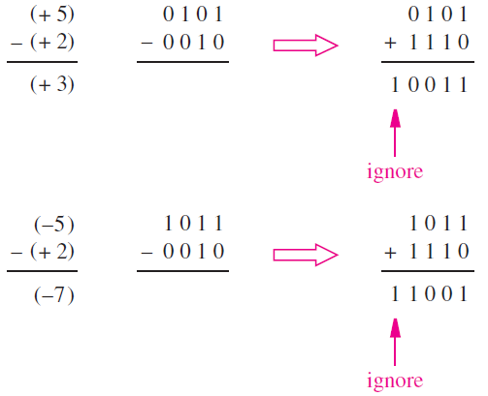
2’s Complement Subtraction
The easiest way of performing subtraction is to negate the subtrahend and add it to the minuend.
This is done by finding the 2’s complement of the subtrahend and then performing the addition.
The operation 5 − (+2) = 3 involves finding the 2’s complement of +2, which is 1110. When this number is added to 0101, the result is 0011 = (+3) and a carry-out from the sign-bit position occurs, which is ignored.
A similar situation arises for (−5) − (+2) = (−7). In the remaining two cases there is no carry-out, and the result is correct.

Slide 35
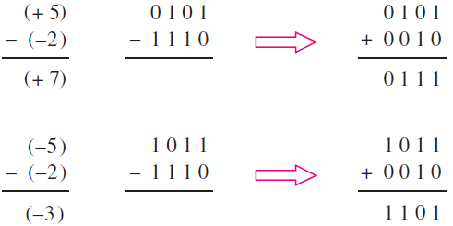
Contd..
Similarly, 5-(-2) & - 5-(-2), we have to take the 2’s complement of (-2) which is 2 itself.

